Slide 1
Student Performance Analysis

Slide 2
Outline
Research Question
Data Source
Data Preparation
EDA
Inference for a Correlation
Predictions - Machine Learning
Conclusion
Running my notebook

Slide 3
Research Question
How do study methods compare for across math, science, and English?

Slide 4
Data Source
Kaggle: Student Performance Data Set
individually structured student records
demographic profile, educational background, learning habits, and academic performance
combines behavioral, environmental, and academic factors
it suitable for a wide range of educational and analytical applications
25000 Rows, Clean, Balance, and Ready for Immediate Download

Slide 5
student_id # of unique student id’s is 15000
age 14 -19
gender - male, female, other
school_type 'public' 'private'
parent_education 'post graduate' 'graduate' 'high school' 'no formal' 'diploma' 'phd'
study_hours 0.5 – 8.0
attendance_percentage 50 – 100 %
internet_access 'yes' 'no'
travel_time '<15 min' '>60 min' '15-30 min' '30-60 min'
extra_activities 'yes' 'no'
study_method 'notes' 'textbook' 'group study' 'coaching' 'mixed' 'online videos'
math_score high score = 100, low score = 0
science_score high score = 100, low score = 0
english_score high score = 100, low score = 0
overall_score high score = 100, low score = 14.5
final_grade ['e' 'd' 'b' 'f' 'c' 'a'] - I am not sure what an “e” grade is

Slide 6
Data Prep
Eliminated 10,000 duplicates
Verified that there was no missing data
Did Univariate Analysis

Slide 7
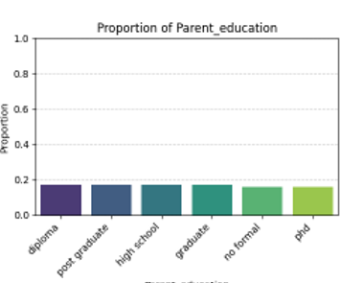
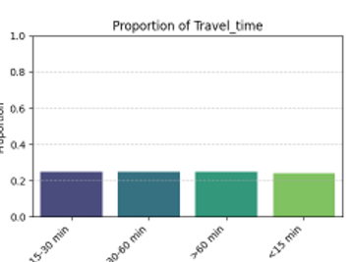
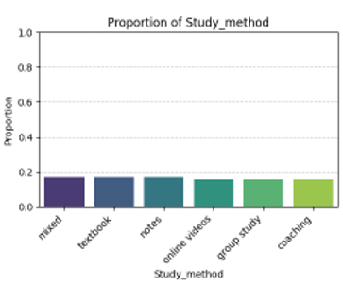
Univariate Analyis
Bar charts for Categorical Variables - examples

Slide 8
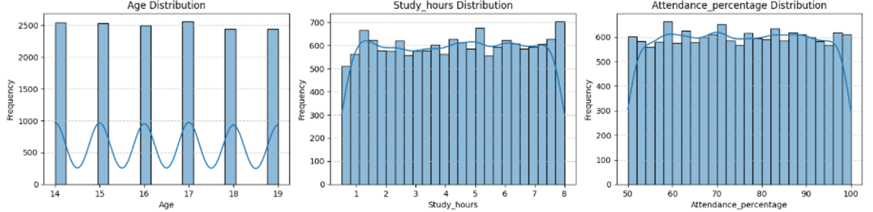
More Univariate Analysis
Histograms for Numerical Variables - examples

Slide 9
I began to question my choice of Data Set
It turns out it is synthetically generated.
UGH

Slide 10
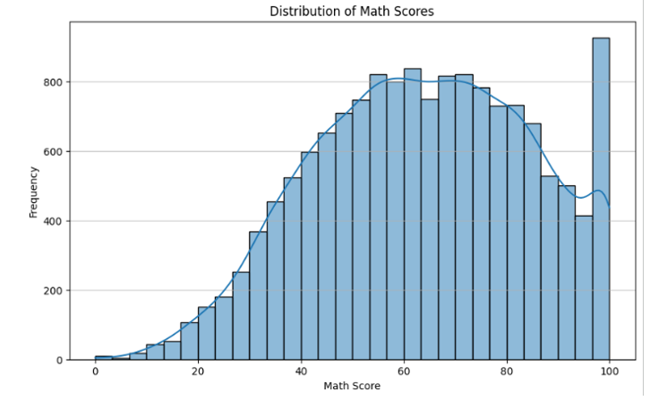
Histograms of scores

Slide 11
Exploratory Data Analysis
Bivariate Analysis
Number vs categorical
Number vs number
Categorical vs categorical

Slide 12
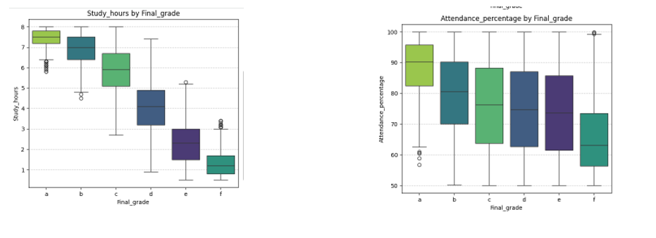
Box/Violin Plots for Numerical VS Categorical Variables

Slide 13
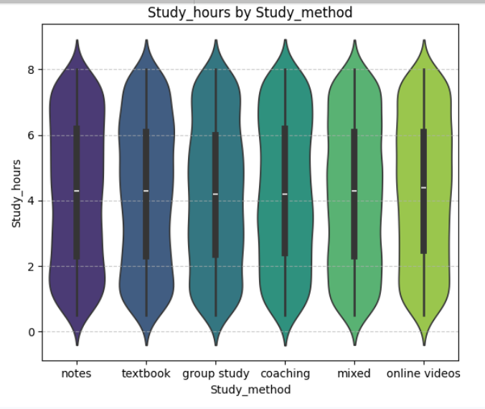
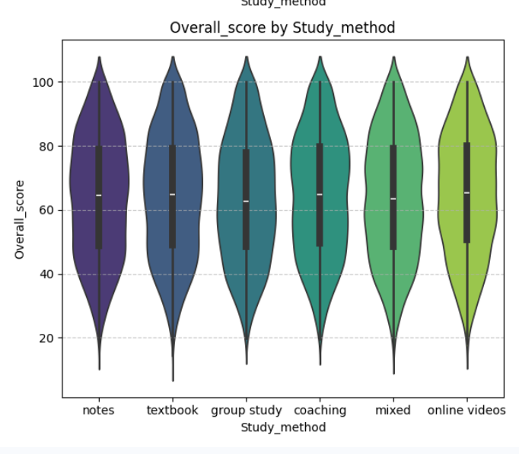
The rest….

Slide 14
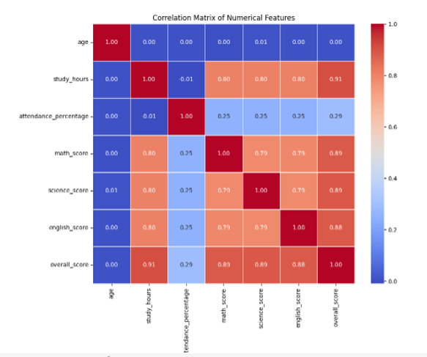
Correlation Matric for Numerical Values

Slide 15
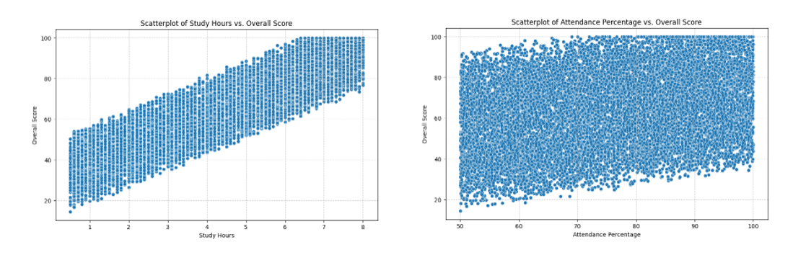
Scatter Plots

Slide 16
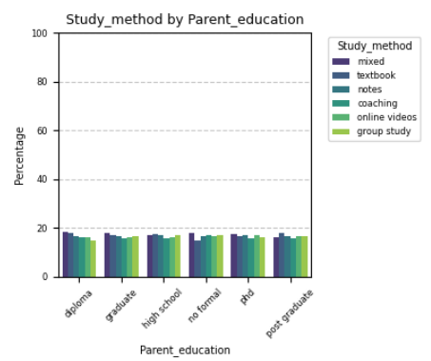
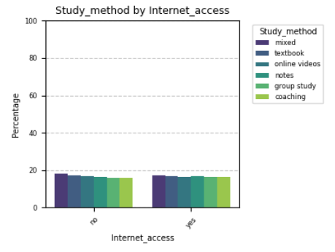
Relationships between Categorical Variables

Slide 17
Summary of EDA
Going forward, I will be focusing on the predictive value of study_hours and attendance_percentage on scores.

Slide 18
Hypothesis Testing for a Correlation: Overall Score versus Study Hours
Null Hypothesis:
The correlation between overall_score and study_hours is 0.
Alternative Hypothesis:
A positive correlation exists between overall_score and study_hours.

Slide 19
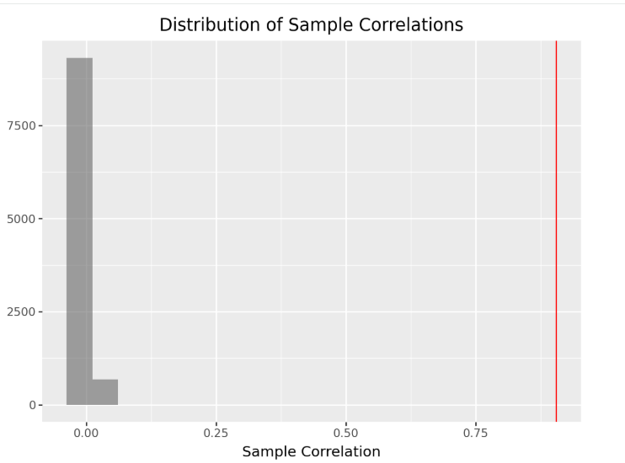
The sample correlation coefficient is 0.9058848411126499
Histogram of 10000 simulated sample Correlations
P-Value = 0
There is evidence to conclude that there is correlation between study_hours and overall_score.

Slide 20
Machine Learning
Data was split into training and test dataframes. 12000, 3000
Linear Regression Models – target is overall_all score
overall_score versus study_hours
overall_score versus attendance_percentage
Multiple linear regression with 2 quantitative explanatory variables – overall_score versus study_hours and attendance_percentage
Logistic Regression Models - target is Grade “A”
“A” Grade vs Study Hours
“A” Grade vs Parent Education & Internet Access

Slide 21
Model Validation
Linear Regression:
MSE and R squared
Scatter Plot
Logistic Regression:
Confusion Matrix
Overfitting and Underfitting Analysis

Slide 22
Conclusion
The most useful predictors of overall_test score is study_hours and attendance_percentage and the analysis recommends that more studying and better attendance improves test scores.
Multiple Linear Regression Equation:
overall_score = (17.21 * study_hours) + (5.63 * attendance_percentage) + 64.06
For raw study_hours = 5.5 and raw attendance_percentage = 85.0: Scaled study_hours = 0.57 Scaled attendance_percentage = 0.69 Predicted overall_score = 77.75

Slide 23
Model Results on Training and Test Data Sets
Multiple Linear Regression Model (Training Data):
R-squared: 0.91 Mean Squared Error (MSE): 32.72
Multiple Linear Regression Model (Test Data):
R-squared: 0.91 Mean Squared Error (MSE): 33.18
The results MSE and R squared values are robust and similar for training and test data, suggesting a balanced model.

Slide 24
Evalutating the Model
The amount of variation in the overall score that is explained by the model is 91%.
The average distance between our prediction and the actual overall score is 5.7. (square root of MSE)

Slide 25
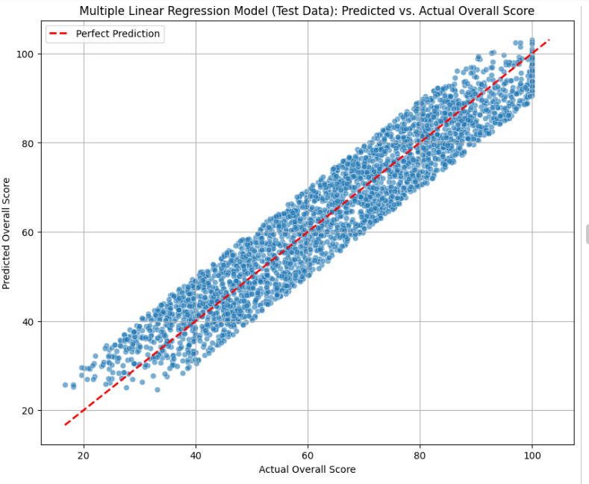

Slide 26
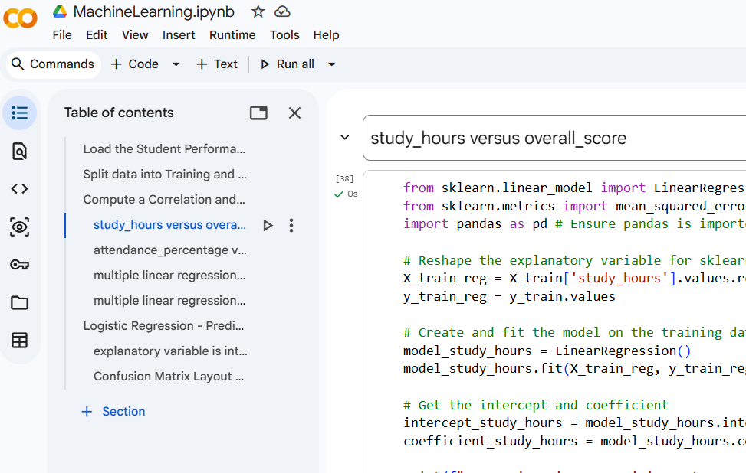
Running my Notebook
Generated using Google Colab

